Slide 1

PATExpert
Semantic Representation Framework
Aristotle University of Thessaloniki

Slide 2
Overview
Patent Content
PATExpert’s Knowledge Modules
Ontologies Infrastructure
  SUMO
    PULO
      Patent Structure Ontology
      Patent Drawings Ontology
      Patent Metadata Ontology
    Patent Domain Ontology
Conclusions

Slide 3
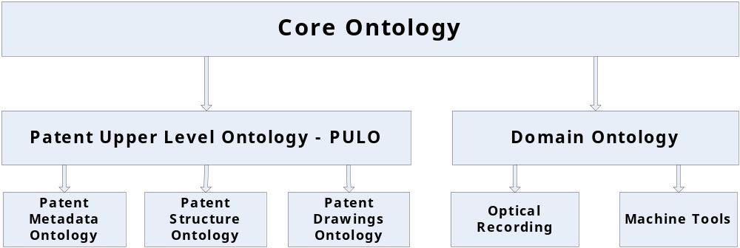
PATExpert’s Knowledge Modules

Slide 4
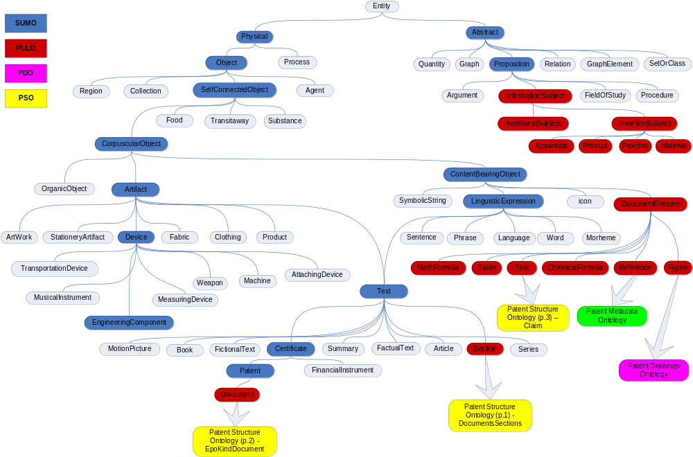
Ontology Infrastracture
Notes:
Giati 2 diaforetika concept text??

Slide 5
Core Ontology
Core ontologies characteristics
key building blocks that enable the scalable assimilation of information from diverse sources.
contain specifications of domain independent concepts and relations
define basic concepts that are common across a variety of domains
provide the basis for specialization of domain-specific concepts and vocabularies
provide ease integration and alignment at later stage.
Basic Core Ontologies
DOLCE
SUMO
SUMO selected for PATExpert
Open source
provides single, pragmatic ontology for use in variety of applications
Integration of patent domain-specific ontologies by means of common SUMO concepts / relations
reuse/integration of fundamental concepts and properties
completely mapped onto the WordNet. The linguistic semantic analysis tasks.
SUMO high level concepts and properties provide the basis for the construction of the other ontology modules

Slide 6
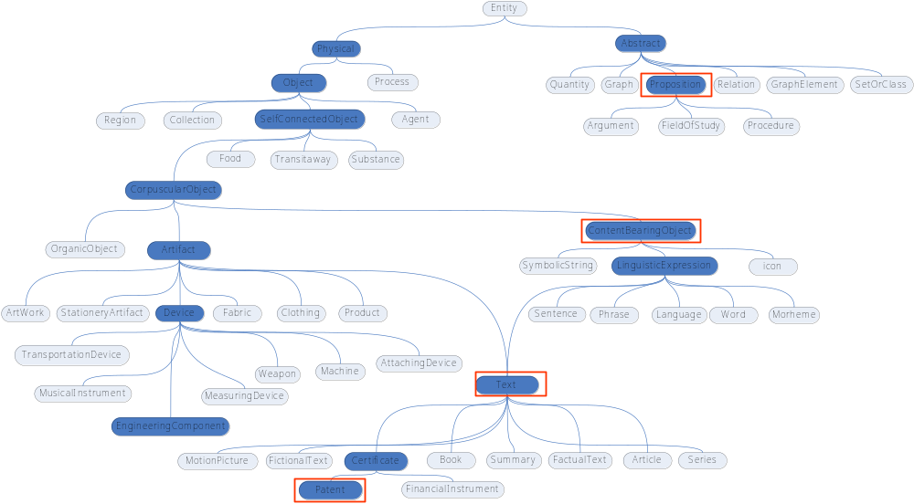
SUMO
Objects that expresses
information
Notes:
Maybe add in big letters some sample concepts and what kind of knowledge they can encode

Slide 7
PULO
Patent Upper Level Ontology (PULO)
provides patent specific concept configurations and terminology
acts as a bridge (midlevel ontology) between the high-level abstractions of SUMO and the low-level details of the other ontologies in PATExpert.
includes all patent-specific concepts that are generic
PULO supports straightforward integration of the ontological modules in PATExpert framework.

Slide 8
PULO
SUMO:ContentBearingObject
DocumentElement
ChemicalFormula
Figure
Table
Reference
MathFormula
Text
Patent Drawings
Ontology
Patent Metadata
Ontology
Patent Structure
Ontology (p.1) -
Claim
Notes:
All the embedded content bearing document elements : Chemical Formula, Figure, Table, Reference, MathFormula and Text. All these multimedia objects may contain characters, words, numbers or special symbols. The correlation between text and drawings may be encoded in a number of different ways. The most standard way is numbering of captions of drawings, diagrams, etc. and numbering of components of objects depicted within drawings. The numbering allows for an unambiguous referencing of the object in question within the textual part.

Slide 9
PULO
SUMO:Patent
SUMO:Text
SUMO:Abstract
Document
Section
SUMO:Proposition
InformationSubject
Patent Structure
Ontology (p.2)–
EPO Kind
Documents
Patent Structure
Ontology (p.3) –
Patents Documents
Sections
InventionSubject
AdditionalSubject
Apparatus
Process
Material
Product

Slide 10
Patent Structure Ontology
Patent documents possess a standard, predefined structure that ensures their uniform presentation
Patent Document Structure Ontology
provides the structural composition of a patent document.
comprises all concepts needed for a comprehensive description of a patent document structure.
draws upon WIPO’s and EPO’s patent document layout standards.
Main role of structure ontology
guide and support the analysis of patents documentation
provide links to other ontologies
Patent sections
Description Section, Claims Section, Drawings Section
Patent Sections – Kind Code
A1 documents have exactly one Description Section, Claim Section, Drawing Section, Search Report Section

Slide 11
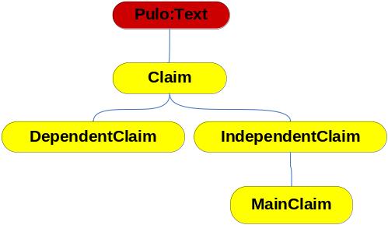
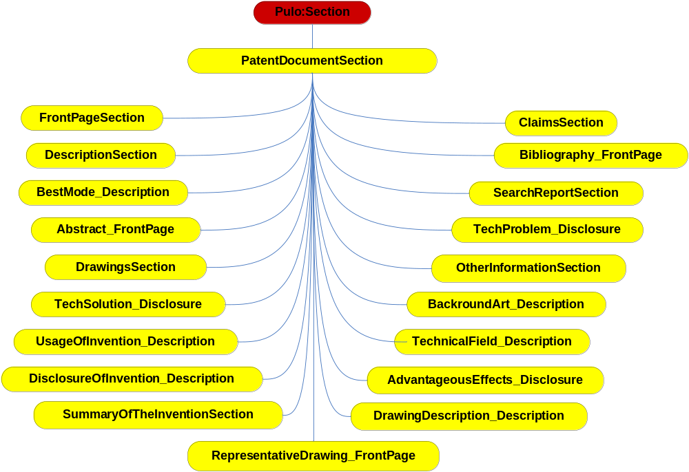
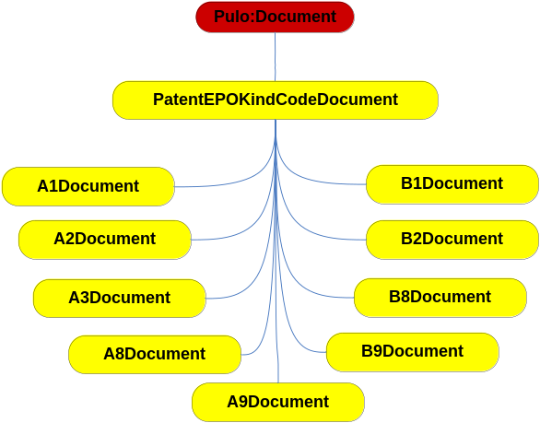
Patent Structure Ontology

Slide 12
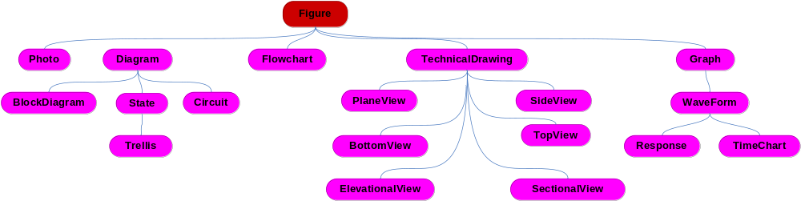
Patent Drawings Ontology
Models the figures of patent documents
Types of drawings
Graph, Flowchart, Photo, Diagram, TechnicalDrawing
Relations to concepts and textual references
conveys-Information-Subject, has-Figure-Label

Slide 13
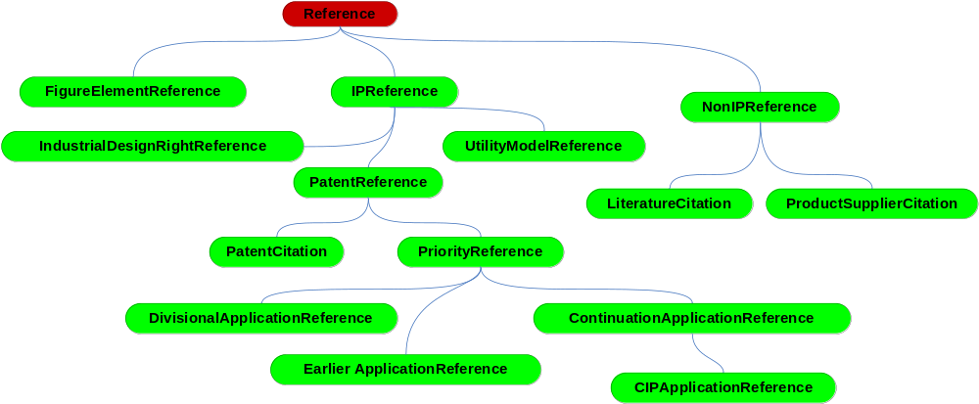
Patent Metadata Ontology
Types of metadata classification
Explicit metadata and Implicit metadata :
Explicit metadata is information retrieved directly from patent documents
Implicit metadata involves patent processing for information extraction
Internal data and External data
Internal metadata derived from a single patent document
External data need to consider other patent documents or other data sources
Major areas of patent metadata
Bibliographical information
References
Patent Families, Patent State,
Legal Events
Notes:
Reference -> IPReference (PatentReference, etc) / Non IPReference (Literature Citation)
State -> Opposition Rejected, International Application Published

